Slide 1
What IG PySIG Did Using Python
A Glimpse
Jiacheng Pan

Slide 2
Outline
PCCT
PCCT GUI
DRC Compare Tool
Random (Tcl) UI / option Coverage Analyzer (on-going)

Slide 3
PCCT
Python Code Coverage Tool
Useful for
recipe_library code coverage (python and Corbasic)
Proteus frozen python code coverage
RMT code coverage
An integrated tool for evaluating python code coverage
For Proteus

Slide 4
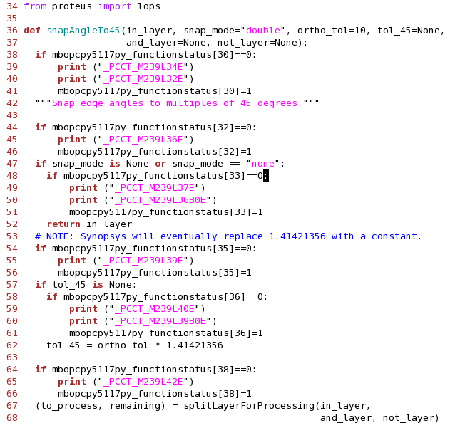
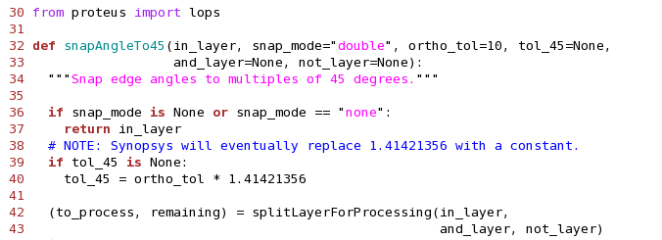
PCCT Functionality
Convert
Insert codes for collecting line coverage statistics
Convert into scripts with coverage-data-collection harness
M239L39B0E:
File number: 239
Line number :39
Branch number: 0
End

Slide 5
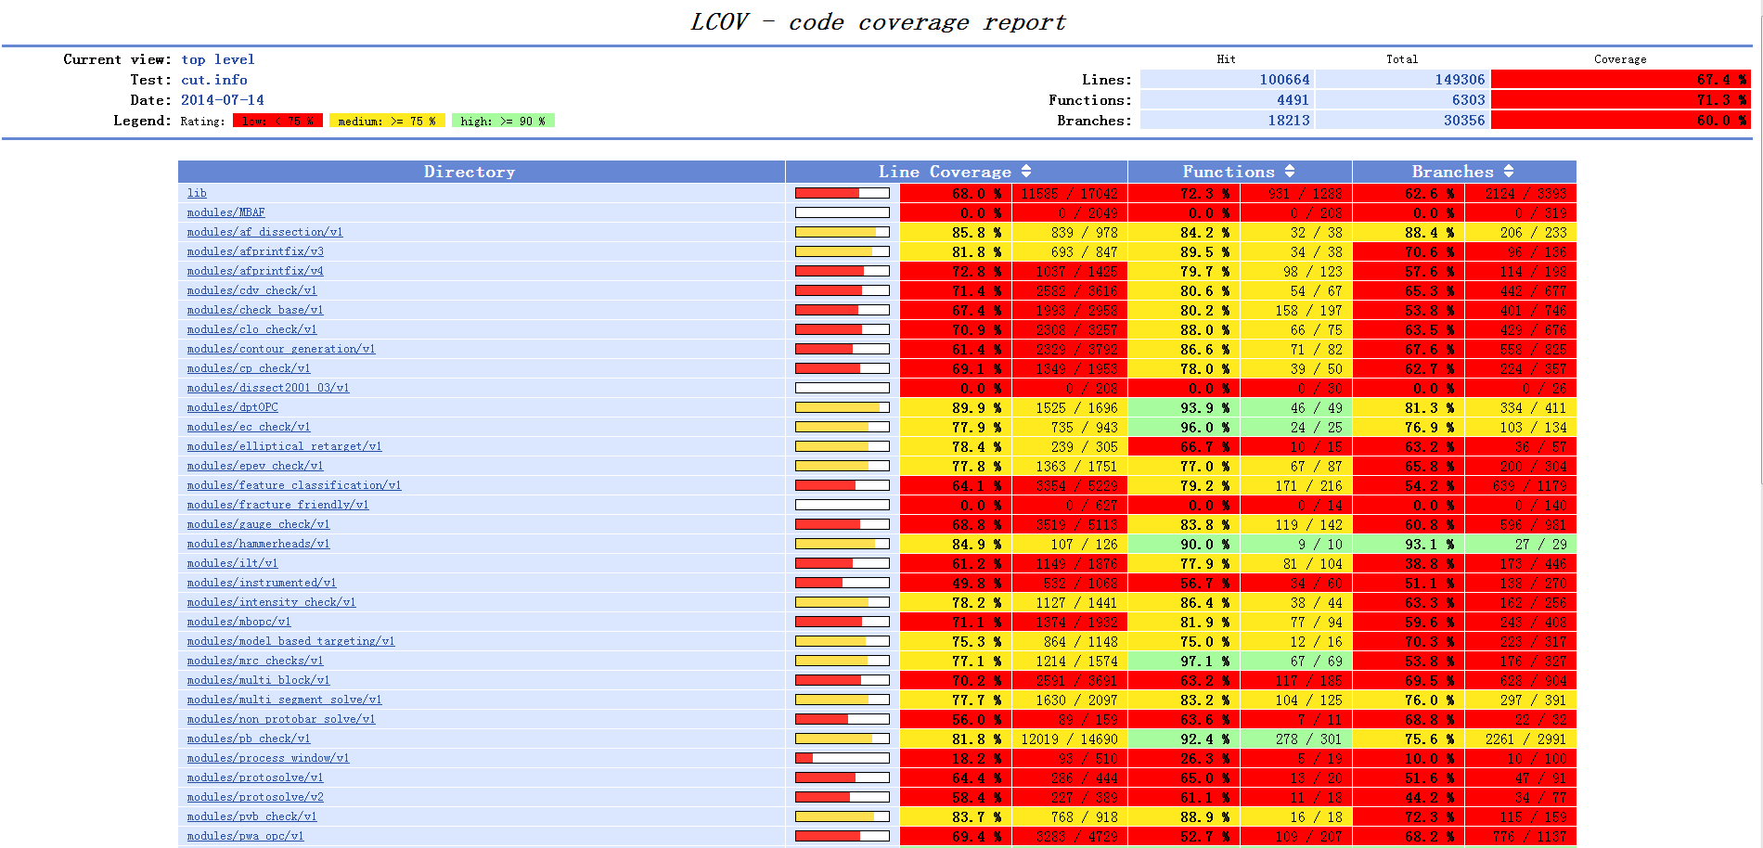
PCCT Functionality
RunCase & Extract & Report
Cases running
Data collection
Data presentation

Slide 6
PCCT
What Python does
Native support for line coverage statistics collection
Easy-to-use glue logic for combining different utilities together
ltg_test for case running
Statistics collection
Data presentation in webpage
Abundant libraries at disposal
AST for script parsing
LCOV for data presentation

Slide 7
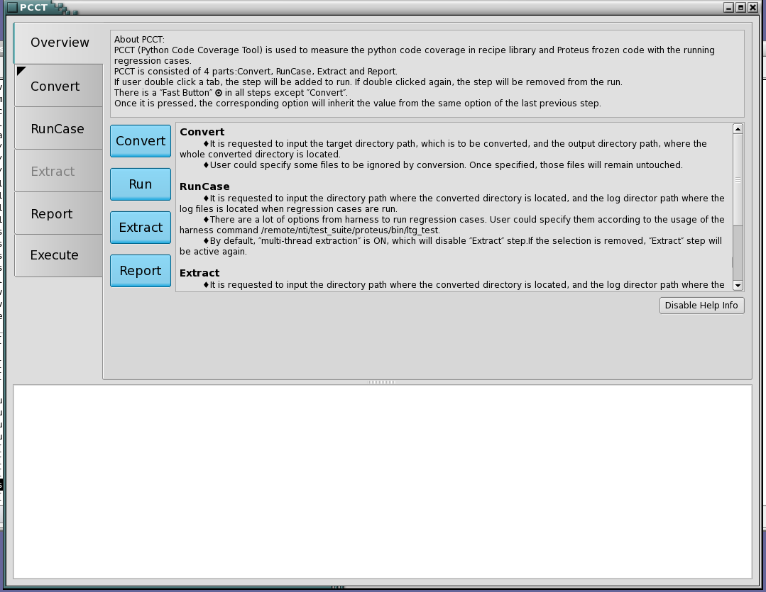
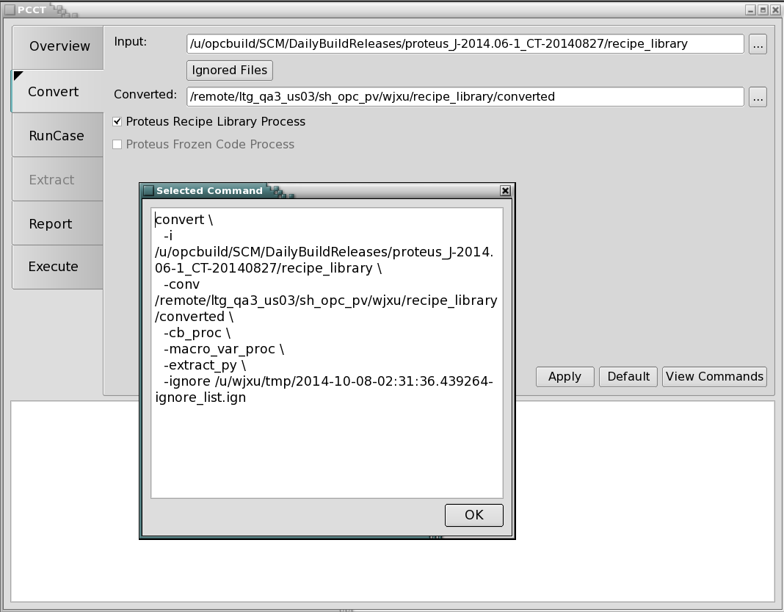
PCCT GUI
A GUI wrapper for PCCT
Using PyQt
Pretty good-looking
Easily and quickly implemented

Slide 8
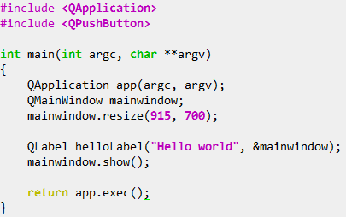
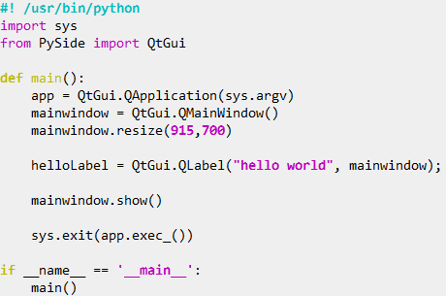
PCCT GUI
What Python does
Still, as a good glue logic
As a means of swift implementation
Method calling very similar to Qt C++
Only easier
Debugging and modification is easy

Slide 9
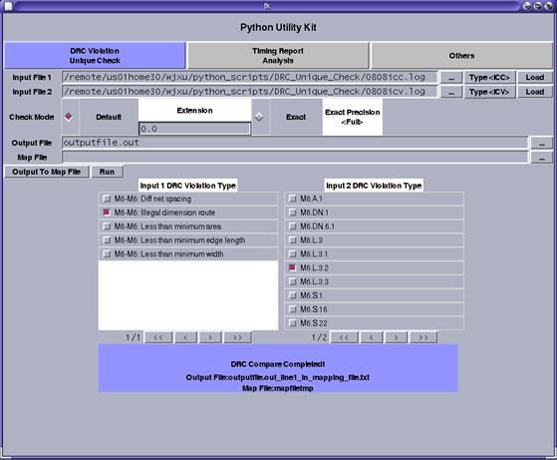
DRC Compare Tool

Slide 10
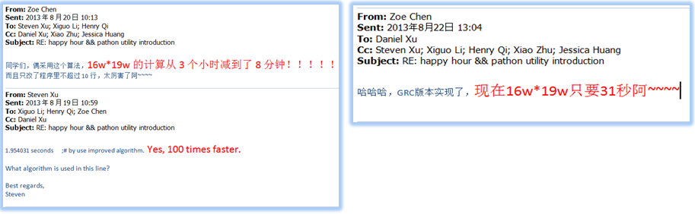
DRC Compare Tool
Text processing
Python makes it easier to implement ideas faster

